Slide 1
Communications in Emergencies
Igor Jenčič
Jožef Stefan Institute, Ljubljana, Slovenia
igor.jencic@ijs.si

Slide 2
Learning objectives
To understand the need for planning communication with public in emergency situations.
To describe the cycle for organizing and implementing public communication activities.
To describe public communication roles of authorities in emergency situations.
To understand the purpose of the INES scale.
To describe the three areas of impact by which nuclear or radiological events are classified.

Slide 3
Contents
Planning for public communication in emergencies
Organization of emergency communication
Roles of authorities
INES

Slide 4
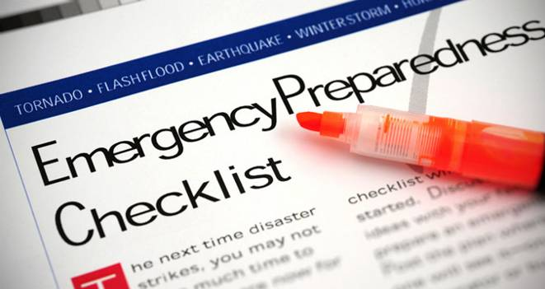
Introduction
Public behaviour during emergencies:
  can be unpredictable
  may affect the emergency response
Regulators must:
  be prepared for communication in emergencies
  understand the psychological roots ⇒ Risk communication

Slide 5
Importance of emergency communication
„Public communication is one of the most important challenges in emergency management. An event may not be considered as an emergency to experts but is perceived very differently by the general public. Communicating effectively with the public about radiation emergencies is key to successful emergency management.“
(Communication with the Public in a Nuclear or Radiological Emergency, EPR-Public Communications 2012, EPR Series, IAEA, Vienna, 2012)

Slide 6
Planning for emergency communication
Large scale emergencies attract great public and media interest
Public communication is one of key activities of emergency response system
Plans and procedures are necessary for public communications in emergency

Slide 7
Plans and procedures
Plans and procedures for emergency situations need to cover a range of activities:
  provision of information to the public and media
  media monitoring and media relations
  public hotlines for questions
  monitoring and addressing rumours and misleading information etc.
Coordination of plans and procedures of different response organizations:
  need for consistency in messages given at all levels

Slide 8
Anticipation of audiences in emergencies
Each emergency will have different audiences
  audiences may even change during an emergency
  directly or indirectly involved in the emergency
Some audiences may be more clearly and directly affected by the potential risks
  dependent on the information communicated
Other audiences may not actually be exposed to radiation
  claim to be interested or affected by the overall situation

Slide 9
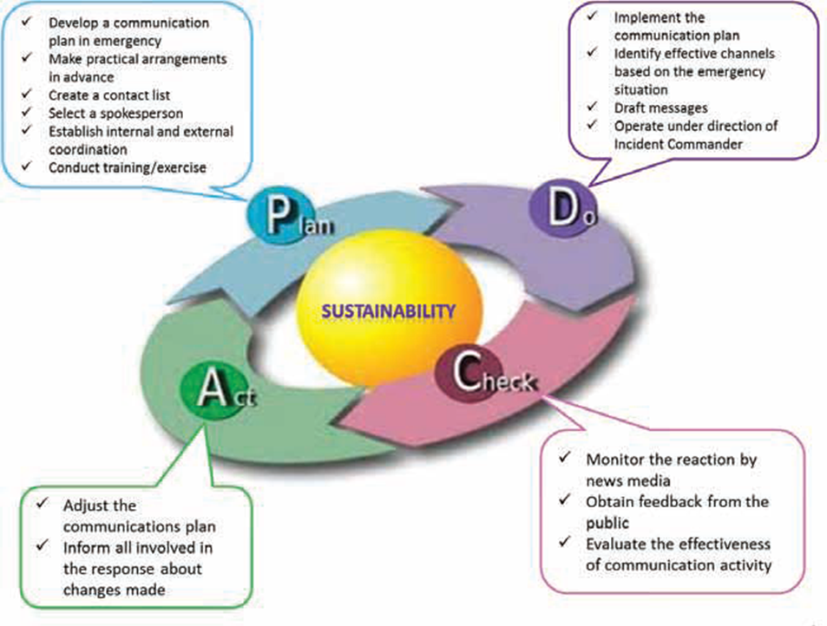
Organizing and implementing the communication

Slide 10
Establishment of a Public Information Centre
Point from where media briefings are to be provided
Headed by Public Information Officer (PIO)
PIO needs to be part of a broader emergency response command system
In case of larger emergencies:
  Public Information Team

Slide 11
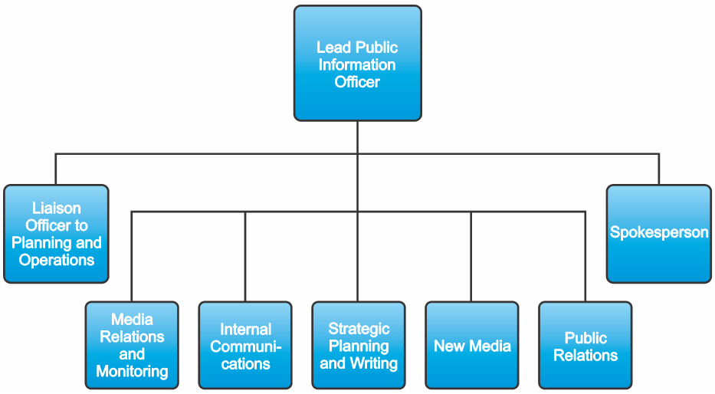
Basic structure of Public Information Team

Slide 12
Roles of authorities
Local authorities
National authorities
International level of coordination

Slide 13
Role of local authorities
In-depth knowledge of the community
Source of valuable information to national authorities
Communicate about what they are doing to respond to a emergency
  information and services in all phases of emergency
  most intensively in case of evacuation or in recovery phase
Must provide consistent information to media and public
  clear allocation of responsibility for communication
  coordination of communication

Slide 14
Role of national authorities
Coordinate public communications at the national level
  avoid contradictory messages and misinformation between the different organizations involved in the response at any level (from licensee and local level to national level).
Response structure should be planned in advance
  roles and responsibilities of the organizations involved
  reflected in all organizational and national response plans

Slide 15
International level of coordination
Convention on Early Notification of a Nuclear Accident:
  obligation to notify other states and the IAEA about emergencies that are of radiological safety significance to other states.
Incident and Emergency Centre (IEC) @ IAEA:
  list of officially designated contact points
Secure communications platform USIE (Unified System for Information Exchange on Incidents and Emergencies)
Besides IAEA, role for FAO, WHO, WMO
  Coordination among them is ensured through the Inter-Agency Committee on Radiological and Nuclear Emergencies (IACRNE)

Slide 16
INES
International Nuclear and Radiological Event Scale
  developed by the IAEA and the OECD/NEA in 1990
A communication tool
  general public
  media
  technical community
Safety significance of nuclear and radiological events

Slide 17
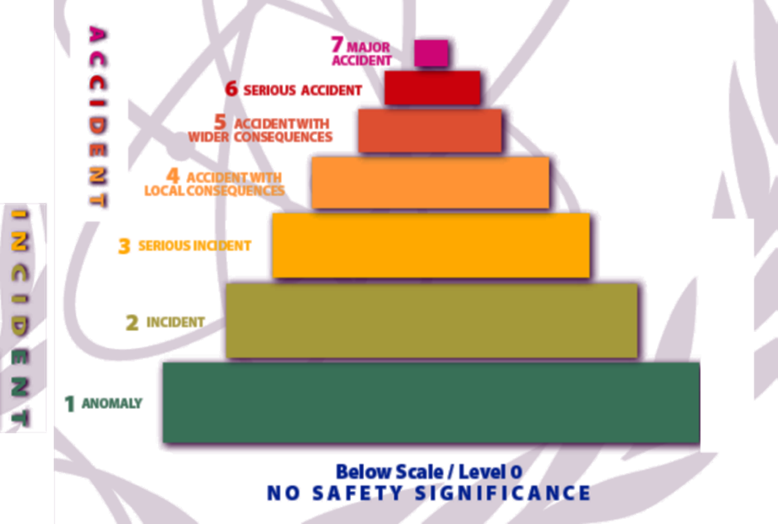
The INES scale
The scale is designed so that the severity of an event is about ten times greater for each unit increase in level on the scale.

Slide 18
Rating of events on INES
Consideration of three areas of impact:
People and the Environment
  radiation doses to people
  amount of radioactive material released into the environment
Radiological Barriers and Control
  primary barriers significantly damaged?
  primary barriers intact but major spillage of radioactive materials or significant increase in the dose rate?
Defence-in-Depth
  measures to prevent accidents did not function as intended

Slide 19
Examples of INES rating
 | People and Environment | Radiological Barriers and Control | Defence-in-Depth
7 | Chernobyl, Ukraine,1986 Significant release of radioactive material to the environment resulting in widespread health and environmental effects Fukushima, Japan, 2011 Significant release of radioactive material to the environment resulting in widespread environmental effects
6 | Kyshtym, Russian Federation, 1957 Significant release of radioactive material to the environment after the explosion of a high activity waste tank
5 | Windscale pile, UK, 1957 Release of radioactive material to the environment following a fire in the reactor core Goiania, Brazil, 1987 Four people died after being overexposed from an abandoned and ruptured high activity source | NPP Three Mile Island, USA, 1979 Severe damage to the reactor core
4 | Tokaimura, Japan, 1999 Fatal overexposures of workers following a criticality event at a nuclear facility New Delhi, India, 2010 Radioactive material in scrap metal facility resulting in acute exposure of scrap dealer Stamboliysky, Bulgaria, 2011 Overexposure of four workers at an irradiation facility, | Saint Laurent des Eaux, France, 1980 Melting of one channel of fuel in the reactor with no release outside the site

Slide 20
Examples of INES rating (cont'd)
4 | Tokaimura, Japan, 1999 Fatal overexposures of workers following a criticality event at a nuclear facility New Delhi, India, 2010 Radioactive material in scrap metal facility resulted with in acute exposure of scrap dealer Stamboliysky, Bulgaria, 2011 Overexposure of four workers at an irradiation facility, | Saint Laurent des Eaux, France, 1980 Melting of one channel of fuel in the reactor with no release outside the site
3 | Lima, Peru, 2012 Severe overexposure of a radiographer | Sellafield, UK, 2005 Release of large quantity of radioactive material, contained within the installation Fleurus,Belgium, 2008 Release of Iodine-131 into the environment from the radionuclide production facility | Vandellos, Spain, 1989 Near accident caused by fire resulting in loss of safety systems at the nuclear power station
2 | Atucha, Argentina, 2005 Overexposure of a worker at a power reactor exceeding the annual limit Paris, France, 2013 Overexposure of a practitioner in interventional radiology exceeding the annual limit | Cadarache, France, 1993 Spread of contamination to an area not expected by design | Forsmark, Sweden, 2006 Degraded safety functions for common cause failure in the emergency power supply system at the nuclear power plant NPP Laguna Verde-2, Mexico, 2011 Reactor trip due to high pressure in the reactor pressure vessel
1 | NPP Rajasthan-5, India, 2012 Exposure of two workers in the nuclear power plant beyond the dose constraints |  | NPP Olkiluoto-1, Finland, 2008 Fast stop of the main circulation pumps and simultaneous loss of their fly wheel systems during reactor scram
0 |  | Colombo, Sri Lanka, 2012 Discovery of consumer goods contaminated with Co-60 | NPP Krško, Slovenia, 2013 Discovery of damaged fuel rods during core unloading and fuel inspections

Slide 21
Scope of INES Scale
INES covers events:
at nuclear facilities;
involving sources in industry and medicine;
during transport of radioactive material;
in which radioactive sources or packages were lost or stolen;
discovery of orphan sources;
involving the unplanned exposure of individuals in other regulated practices (such as processing of minerals).

Slide 22
What INES Scale is not for
It is not appropriate to use INES for:
comparing safety performance between facilities, organizations or countries
  statistically small numbers of events at Level 2 and above
  differences between countries in reporting minor events
initiation of protective actions to an emergency
  classification of emergencies for the purpose of triggering appropriate emergency response actions

Slide 23
Summary
Public communication is one of key activities in emergency response
Plans and procedures are necessary
Roles of authorities (local, national, international)
INES – 7-number scale for classifying events

Slide 24
Key points
Public behaviour during emergencies:
  can be unpredictable
  may affect the emergency response
Must include communication in plans & procedures
INES

Slide 25
List of abbreviations
FAO … Food and Agriculture Organization
IACRNE … Inter-Agency Committee on Radiological and Nuclear Emergencies
IAEA … International Atomic Energy Agency
IEC … Incident and Emergency Centre
INES … International Nuclear and Radiological Event Scale
NEA … Nuclear Energy Agency at OECD
OECD … Organisation for Economic Co-operation and Development
PIO … Public Information Officer
USIE … Unified System for Information Exchange on Incidents and Emergencies
WHO … World Health Organization
WMO … World Meteorological Organization

Slide 26
References
Arrangements for Preparedness for a Nuclear or Radiological Emergency, IAEA Safety Standards Series No. GS-G-2.1, IAEA (2007).
Criteria for Use in Preparedness and Response for a Nuclear or Radiological Emergency, IAEA Safety Standards Series No. GSG-2, IAEA (2011).
Operations Manual for Incident and Emergency Communication Emergency Preparedness and Response No. EPR-IEComm 2012, IAEA (2012).
INES: The International Nuclear and Radiological Event Scale User's Manual. 2008 Edition, IAEA, Vienna (2013).

